Slide 1
Statistics (python)
Andrew Beatty
Andrew.Beatty@gmit.ie
Programming for cybersecurity

Slide 2
basics
MMean of a Dataset
  The mean, or average,
Median of a Dataset
  The median of a dataset is the value that, assuming the dataset is ordered from smallest to largest, falls in the middle
The mode
  is the value that appears most frequently in a data set.ean, Median, and Mode

Slide 3
Variance
Variance
  Variance is a measure of spread. It is calculated by finding the average of the squared differences between every observation and the mean. The resulting value is in units squared.
np.var()
Standard Deviation
The standard deviation is a measure of a dataset’s spread. It is calculated by taking the square root of the variance of a data set. The resulting value has the same units as the original data.
np.std()

Slide 4
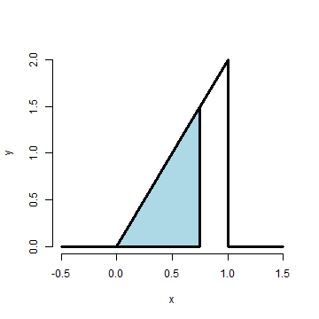
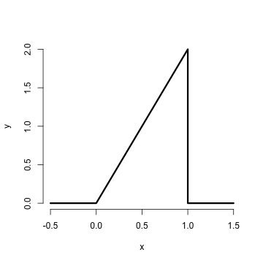
Distributions

Slide 5
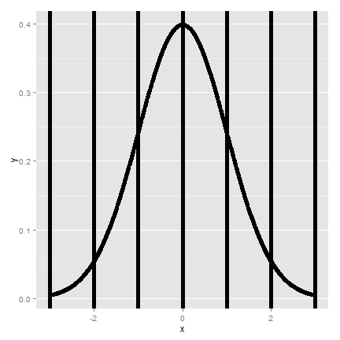
Normalised

Slide 6
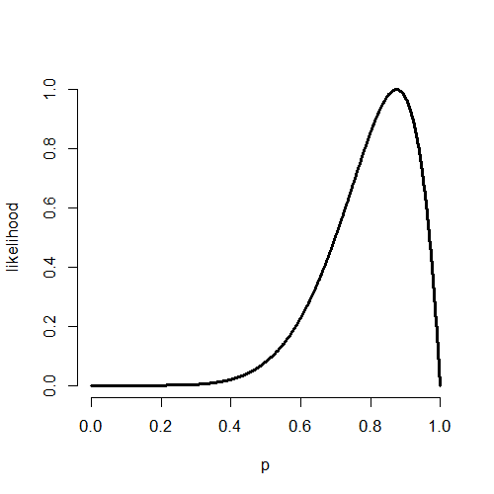
other

Slide 7
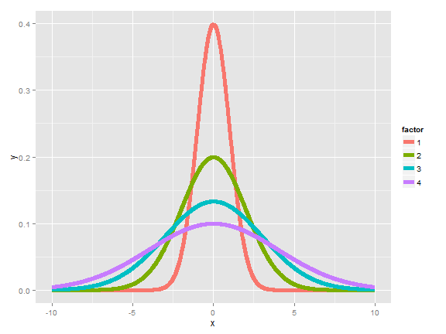
Take samples of values (expected values)

Slide 8
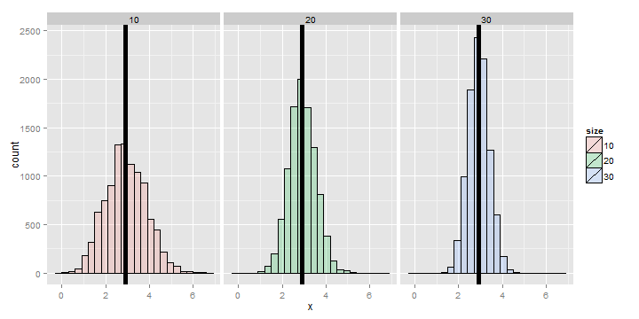
Same with variance

Slide 9
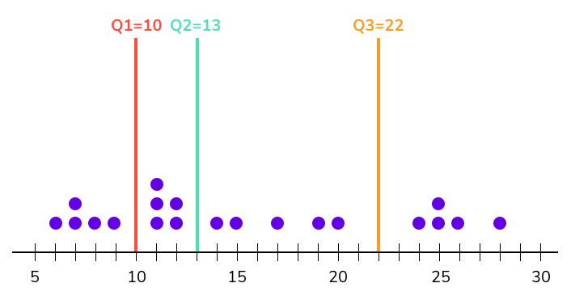
Quantiles
Quantiles
Quantiles are the set of values/points that divides the dataset into groups of equal size. For example, in the figure, there are nine values that splits the dataset. Those nine values are quantiles.
Quartiles
The three dividing points (or quantiles) that split data into four equally sized groups are called quartiles. For example, in the figure, the three dividing points Q1, Q2, Q3 are quartiles.
import numpy as np
data = [1,2,3,4,5]
first_quartile = np.quantile(data, 0.25)
numpy.quantile — NumPy v1.21 Manual

Slide 10
interquantile
Interquartile Range Definition
The interquartile range is the difference between the first(Q1) and third quartiles(Q3). It can be mathematically represented as IQR = Q3 - Q1
Interquartile Range and Outliers
The interquartile range is considered to be a robust statistic because it is not distorted by outliers like the average (or mean).
# Eventhough d_2 has an outlier, the IQR is identical for the 2 datasets
d_1 = [1,2,3,4,5,6,7,8,9]
d_2 = [-100,2,3,4,5,6,7,8,9]

Slide 11
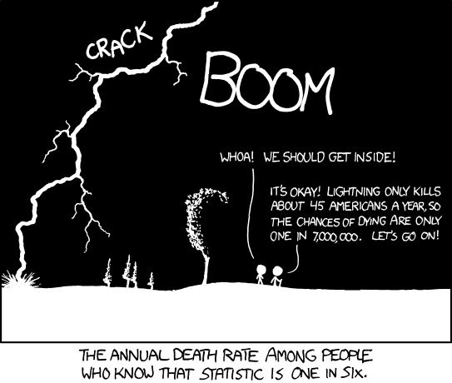
probability

Slide 12
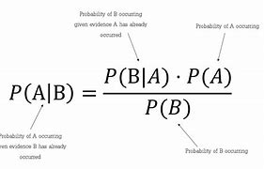
Bayes rule
Very good video by 3 brown one blue

Slide 13
Standard error

Slide 14
Correlation
import numpy as np
my_rho = np.corrcoef(x_simple, y_simple)
from scipy import sci
corr, _ = sci.pearsonr(list1, list2)
For the correlation coefficient,
  1 => positive correlation,
  -1 => negative correlation,
  0 => no correlation.
The P-value:
  How certain we are about the correlation that we calculated.
  <.001 => strong certainty
  >.001 and <.05 => moderate certainty.
  >.05 < .1 => weak certainty.
  >.1 => no certainty

